Slide 1
Tax Planning & Superannuation Strategies
Webinar: Thursday 9th June 2022 @ 12.30pm
Notes:
Welcome to this Webinar on Tax Planning & Superannuation Strategies - my name is Peter Locandro, the Managing Partner of Financially Sorted.
I hope that you are all safe and well, nit getting knocked around with Covid or the Flu going around and getting some normality back into your lives.
We as a team at Financially Sorted thought that it would be great to talk & communicate to our clients about what should be happening right now, well before 30th June 2022 and the end of the financial year.
As a team of tax professionals where are here to assist. We will continue to communicate with you all, whether that be via email, newsletters, conversations you are having with our team, social media, texts, or via webinars like these ones.
The team at Financially Sorted are here to help you in the areas needed, both today, tomorrow & beyond. Please just ask and we will certainly do our best to assist.

Slide 2
Welcome
Financially Sorted
Moonee Ponds Level 1, Suite 2, 38 Margaret Street
Wheelers Hill Level 2, Suite 10, 622 Ferntree Gully Road
Services
Taxation & Accountancy
Financial Planning & Wealth Creation
SMSF Services
Insurances
Loan & Finance Broking
Bookkeeping Services
Xero & Cloud Accountancy Training
Notes:
The team are back working in the respective offices & we certainly are here to assist.
I would like to say thank you though for the crazy times we currently find ourselves in. Us, like many other businesses, have on occasions had less team members available because of Covid and the Flu going around. I really do appreciate your ongoing support.
We, like many other businesses have created & used technology to the best of our ability.
We will certainly keep you updated when things change, whether it be with technology that we use or as legislation & law interruptions change.
We will continue to run webinars just like these to help with our communication to you and the service you all deserve.

Slide 3
Disclaimer
General Advice Only
The information provided in this seminar/webinar has been prepared for general information purposes only and not as specific advice to any particular person or situation.
Any advice contained in this document is General Advice only and does not take into account any person’s particular investment objectives, financial situation and particular needs.
Before making any decisions, it’s recommended to seek advice from a qualified professional relevant to your particular needs or interests. This may include tax advice from an Accountant &/or Tax Agent, Financial Advice from Licensed Financial Adviser or other professionals where required.
Notes:
General advice only – it has not been designed for your particular situation or taking into account your particular circumstances.
Please seek the appropriate expert advice where needed.
What I will also say at the outset is, there are many rules or strategies that many of our clients and businesses use to help legally minimise tax liability every year.
In 60 minutes, we certainly can’t cover everything and bear in mind that everyone's situation, circumstances and businesses are totally different.
Any tax planning or superannuation strategy even considered should always tie back to your goals & objectives also – what are your goals & objectives?
I or the team are more than happy to talk to your further if needed about your situation.

Slide 4
Agenda
Discussion Points
What is Tax Planning?
Why is Tax Planning So Important?
How can I maximise available Tax Deductions?
Superannuation Strategies to consider and adopt
What to do Next
Notes:
Fantastic to have many clients & along with many new people to register for this webinar and listen in – hopefully, I will go a long way towards helping answer some of the questions or doubts that you have in your mind.
Some of the major discussion points will be as follows:
************* (slide list)*****************.
If anyone has questions, feel free to use the comments tab & providing we have time, I will do my best to answer them all at the end.
A recording of this webinar along with a PDF copy of the slides will be posted on our website for you to access – approx. 24-48 hours afterwards – I will show you where towards the end of this presentation and how to access it all.

Slide 5
Importance
Why is Tax Planning so Important?
“The main objective in tax planning is to reduce the amount of tax either you personally or your business pays”
Leaves more to invest for your future
By knowing or understanding your tax or other liabilities, you can reinvest funds that would otherwise have been earmarked for tax back into your wealth creation strategies
Notes:
Couple of question to ponder:
Business owners, who of you truly know & understand your business numbers?
Discuss margins, improvement strategies – 2% improvement each month can make a massive difference to the bottom line over time. It’s not a 100 meter sprint, it’s a marathon.
Individuals, who truly knows their mortgage or superannuation numbers?
Again, how much do you need to repay each month or each week to get rid of your loan in 7 years rather than 25 years?
How is your superannuation performing – what will your balance be when you are say 60 yrs of age?
How long will your balance last in retirement?
Will it be enough for your desired lifestyle?
Can you do something different to help stimulate the available balance in retirement? We work with many of clients daily to help them with these & many of their questions or concerns.

Slide 6
Importance
Why is Tax Planning so Important? … continued
Tax planning is a process of analysing and evaluating either a business or an individual's financial profile or current financial position
The objective of this activity is to minimise the amount of taxes you pay on your business or personal income “keep your hard earned in your pocket”.
In short, tax planning is employing ways that the government has provided to save tax
It is a perfectly legal method to cut down or defer your annual tax liability
Notes:
Any tax planning needs to be done regularly.
Don’t wait until the 30th May or the 9th June each year, do it monthly or do it quarterly.
Makes the process and effectiveness a lot easier.

Slide 7
Options Available
Why type of Tax Planning is Important & Available?
Tools of Tax Planning:
Accelerating tax deductions
Utilising Government offsets/rebates
Controlling when income is recognised
Reinvestment back into the business

Slide 8
Be Aware
ATO Reviews/Audits
Like anything, the Government & the ATO is looking closely
ATO now chasing outstanding amounts and beginning to conducts reviews/audits again
These questions/reviews/audits will continue and will increase
Be Careful, They are Watching!
Notes:
Before we get stuck into some strategies, please be careful – the ATO & Government have spent a lot of money over the last 2 years, they will, and they are investigating & prosecuting.
Not just with those that have claimed JK illegally, but with tax return lodgments and most likely businesses as well.
I bring to your attention that ATO investigators are trained to investigate, as we are all trained to do our jobs.
They are using technology in the areas such as data matching programs and averaging programs to look areas or taxpayers to audit.

Slide 9
Tax Compliance and Integrity
ATO’s Tax Avoidance
The Government will provide $325.0 million in FY2023/24 and $327.6 million in FY2024/25 to the ATO to extend the operation of the Tax Avoidance Taskforce by 2 years to 30 June 2025
The Taskforce was established in 2016 to undertake compliance activities targeting multinationals, large public and private groups, trusts and high wealth individuals
It also scrutinises specialist tax advisors and intermediaries that promote tax avoidance schemes and strategies
This measure is estimated to increase receipts by $2.1 billion and increase payments by $652.6 million over the forward estimates period
Notes:
Back in March 2022, the Federal Liberal Government brought forward the Budget.
They allocated and promised a lot of money to the ATO and other Government agencies to review, to investigate, to simply ask questions.
Be sure that your records are accurate & up to date.

Slide 10
Tax Compliance and Integrity
Sharing of Single Touch Payroll (STP) data
STP Phase 2 is coming
The Government has committed to the development of IT infrastructure required to allow the ATO to share STP data with State and Territory Revenue Offices on an ongoing basis
Funding for this measure has already been provided and will be deployed following consideration of which States and Territories are able, and willing, to make investments in their own systems and administrative processes to pre-fill payroll tax returns with STP data
Notes:
STP – Phase 2 is coming.
A more detailed email was forwarded to our entire database on the Tuesday, 1st June which highlighted the extra reporting requirements from all employees & the ongoing and extra obligations moving forward.
If you need a copy of that forwarded to you again, please just ask.
This has also been placed on our website under the News section for your reading & the action points required.

Slide 11
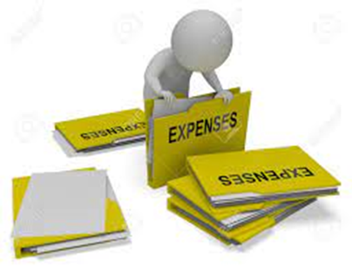
Tax Compliance and Integrity
Notes:
STP – Phase 2 is coming.
A more detailed email was forwarded to our entire database on the Tuesday, 1st June which highlighted the extra reporting requirements from all employees & the ongoing and extra obligations moving forward.
If you need a copy of that forwarded to you again, please just ask.
This has also been placed on our website under the News section for your reading & the action points required.

Slide 12
Maximisation
How can I maximise Tax Planning Options Available?
Income
Objective – to legally minimise
Use salary sacrificing
Utilise a Mortgage Offset Account
Delay income - legally
Notes:
Okay, lets have a look at some strategies – both tax planning & superannuation also.
We will cover the income side of things first & then we will look at expense strategies followed by some super strategies.

Slide 13
Maximisation
How can I maximise Tax Planning Options Available? … Continued
Income
Salary Sacrificing
Salary sacrificing is basically a way to minimise your tax bill.
It involves using your pre-tax salary to buy goods or services that you'd normally buy with your after-tax pay. Because in the eyes of the tax department you're earning less when you are salary sacrificing, they tax you less.
Notes:
Employers – be very careful of FBT implications that may be occurred on your team members of staff utilizing this strategy.
That is another topic for another webinar.

Slide 14
Maximisation
How can I maximise Tax Planning Options Available? … Continued
Income
Salary sacrificing example:
Terry Daniher $120,000 Gross Salary
Salary Sacrifice $13,000 Sends it to his SMSF
Assume No other major issues
Notes:
Okay, let’s have a look at a working example of how salary sacrificing may benefit you.

Slide 15
Maximisation
How can I maximise Tax Planning Options Available? … Continued
Particulars | Pre-Salary Sacrifice (Currently) | Post- Salary Sacrifice (New)
Taxable Income | $120,000 | $107,000
Tax – Personally (incl. Medicare levy) | $34,297 | $29,227
Tax – Superannuation Fund | $ Nil | $1,950
Tax - Savings | $ Nil | $3,120
Notes:
Confirm – this is a very basic example but shows the power of salary sacrificing.
As an extra benefit – there is also an extra amount of $11,050 (after taxes) in your superfund for later in life, for retirement.

Slide 16
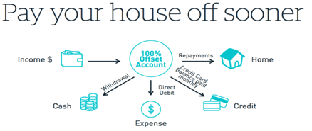
Maximisation
How can I maximise Tax Planning Options Available? … Continued
Income
Mortgage Offset Account
A mortgage offset account is a transaction account that is linked to your home loan.
The account's balance (or a proportion of that balance) is 'offset' daily against your home loan balance. You are only charged interest on the difference between the total loan balance and the amount offset.
Notes:
Let’s have a look at an example.

Slide 17
Maximisation
How can I maximise Tax Planning Options Available? … Continued
Income
Mortgage Offset Account:
Lauren Jackson Home Loan PPR $1,000,000 @ 4%
Cash Account $700,000 @ 2%
Assume No other major issues
Notes:
Okay, let’s have a look at a simple example of how salary sacrificing may benefit you.

Slide 18
Maximisation
How can I maximise Tax Planning Options Available? … Continued
Particulars | No Offset Facility (Currently) | With Offset Facility (New)
Home Loan PPR $1,000,000 @ 4% | $40,000 (Expense) (Non-Deductible) | $ Nil
Cash Account $700,000 @ 2% | $14,000 (Income) (Assessable Income & then Taxed @ MTR) | $ Nil
Home Loan with Offset Account $300,000 @ 4% | $ Nil | $12,000 (Expense) (Non-Deductible)
Overall Savings | $ Nil | $28,000 (plus, tax savings)
Notes:
Okay, let’s have a look at a simple example of how salary sacrificing may benefit you.

Slide 19
Maximisation
How can I maximise Tax Planning Options Available? … Continued
Income
Mortgage Offset Account:
How do you set this up?
We can help - stay tuned!

Slide 20
Maximisation
How can I maximise Tax Planning Options Available? … Continued
Income
Delay Income (Legally)
Defer Invoicing – If your cashflow can stand it, think about deferring your invoicing until after 30 June.
A one-month delay in billing will mean you pay tax on the income a whole year later. Mind you, your customers might want you to bill pre-June so that they can claim a tax deduction. And a few days delay in billing will usually
mean that you get paid a whole month later.
Be careful with such a strategy!

Slide 21
Options Available
What type of Tax Planning is important and available?
Tools of Tax Planning:
Accelerating tax deductions
Utilising Government offsets/rebates
Controlling when income is recognised
Reinvestment back into the business

Slide 22
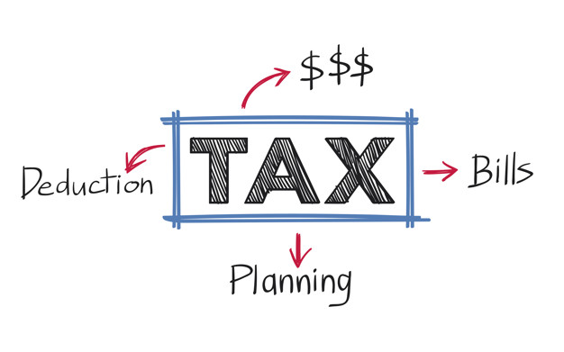
Options Available
Why type of Tax Planning is important & available? … Continued
Tools of Tax Planning:
Bring forward Expenses (a few months)
Prepayment of Expenses (up to 12 months)
Full Expensing of Eligible Assets - $150,000 Covid Relief
Superannuation Strategies & Contributions

Slide 23
Options Available
Why type of Tax Planning is important & available? … Continued
Tools of Tax Planning:
Bring forward Expenses (a few months)
Bring forward expenditure that will be spent anyway
Notes:
If you are going to spend money in July/August, even in September, possibly do it pre-30th June instead.
Some common examples may include:
Insurance premiums,
printing & stationary,
computer supplies,
office equipment needed,
repairs to your office or work premises,
Telephone & electricity for June – pay in June, not July.
July’s rent
Super SGC contributions – pay before June 30th
The list can go on and on.

Slide 24
Options Available
Why type of Tax Planning is important & available? … Continued
Tools of Tax Planning:
Prepayment of Expenses (up to 12 months)
The “12-month rule” allows for the deduction of a prepaid expense in the current year if the right or benefit paid for does not extend beyond the earlier of:
12 months, or
the end of the taxable year following the taxable year in which the payment is made.
Notes:
Prepaid expenses are common in any business.
Some of these prepaid expenses may include:
Leases or advance rent,
Insurance policies,
Business Advertising or marketing
Perhaps some upcoming subscriptions.
You must be a small business to take advantage of this.
You are a small business entity if you are an individual, partnership, company or trust that:
is carrying on a business
has an aggregated turnover of less than $10 million.

Slide 25
Options Available
Why type of Tax Planning is important & available? … Continued
Tools of Tax Planning:
Full Expensing of Eligible Assets - $150,000 Covid Relief
Business with aggregated annual turnover of up to $5b can deduct the full cost of eligible depreciable assets of any value in the year they are installed
The full expensing period is available from 7:30pm AEDT on 6 October 2020 to 30 June 2023
Government encouraging businesses to spend money on equipment & build for future growth.
Notes:
The full cost of an eligible capital asset that is acquired after 7:30pm AEDT on 6 October 2020 and first used or installed ready for use by 30 June 2023 may be fully deducted.
This deduction is available for any business with an aggregated annual turnover of less than $5b.
The full expense will be available in the income year the eligible capital asset is first used or installed ready for use.
The outright deduction may also be available for the cost of improvements to existing eligible depreciable assets during the full expensing period.
An eligible depreciable asset of any value is eligible for full expensing.
The asset is a new depreciable asset or is the cost of an improvement to an existing eligible asset, unless the taxpayer qualifies as a small or medium sized business, in which case the asset can be second-hand.
Small and medium sized businesses (those with an aggregated annual turnover of less than $50m) can fully deduct second-hand assets purchased and installed during the eligible period.
This would include new equipment for a bakery, medical equipment perhaps in a doctors or dental surgery or the local carpenter or tradie spending some money on major equipment or a brand-new trailer to carry their tools in.

Slide 26
Options Available
Why type of Tax Planning is important & available? … Continued
Tools of Tax Planning:
Accounting Tip
Great – depreciation claim now, less taxable income which equals less taxes today
Be careful, future taxable income, financing requirements & possible GST could arise

Slide 27
Options Available
Why type of Tax Planning is important & available? … Continued
Tools of Tax Planning:
Superannuation Strategies & Contributions
Let’s have a look at this one as a separate strategy
Notes:
Importance of financial

Slide 28
Superannuation Strategies
Superannuation Strategies to consider & adopt
SGC Contributions - $27,500 cap
Personal tax-deductible (concessional) super contributions
Personal non-deductible (non-concessional) super contributions
Split your contributions/balances to your spouse
Consolidating spouses' super balances (SMSF’s)
Notes:
Sections D & E are very technical/complex areas and something that should be investigated on a case-by-case basis.
I am telling you because some of our clients utilise it, can help with Centrelink & wealth creation.
Proper financial planning should be done with superannuation, especially these types of arrangement.

Slide 29
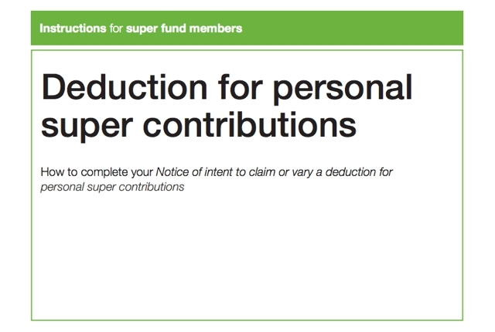
Superannuation Strategies
Superannuation Strategies to consider & adopt
SGC Contributions - $27,500 cap
For the FY2022 financial year, the general concessional contributions cap is $27,500 for all individuals regardless of age
FY2023 the contributions cap – no changes at this point

Slide 30
Superannuation Strategies
Superannuation Strategies to consider & adopt
SGC Contributions - $27,500 cap
Concessional contributions include:
Employer contributions (including contributions made under a salary sacrifice arrangement)
Personal contributions made to be claimed as a tax deduction.
Be Careful - If you have more than one fund, all concessional contributions made to all your funds are added together & counted towards your concessional contributions cap.
Notes:
Taxes – super @ 15% vs outside of super, possibly 30 – 35 or 45% plus.

Slide 31
Superannuation Strategies
Superannuation Strategies to consider & adopt
Personal tax-deductible (concessional) super contributions
Your personal deductible contributions are personal contributions you make to a super fund.
You can claim your super contributions as a tax deduction on your individual tax return if you meet certain eligibility criteria.

Slide 32
Superannuation Strategies
Superannuation Strategies to consider & adopt
Personal tax-deductible (concessional) super contributions
Example
In the FY2022, Charlie is self-employed and earns $50,000
Charlie contributes $5,000 to his super fund.
If he lodges a notice of intent to deduct and his super fund acknowledges that notice:
He can claim a personal tax deduction of $5,000
His taxable income is $45,000 (assuming no other deductions)
Charlie will pay tax on $45,000, not $50,000.

Slide 33
Superannuation Strategies
Superannuation Strategies to consider & adopt
Personal non-deductible (non-concessional) super contributions
Non-concessional contributions are:
From your after-tax income
Not taxed in your super fund
From 1 July 2017 to 30 June 2021, the non-concessional contributions cap was $100,000
From 1 July 2021, the non-concessional contributions cap increased to $110,000 as a result of indexation in line with average ordinary time earnings (AWOTE)
Beware - if you contribute more than the various caps, you may have to pay extra taxes!
Notes:
Discuss the carry forward rule - $330K over 3 years.
Advantage – get money into a less taxed or tax-free environment possibly.

Slide 34
Superannuation Strategies
Superannuation Strategies to consider & adopt
Carry Forward Rule – Concessional Contributions
Applies from the FY2020
Allows extra concessional contributions to be made above the general concessional caps, without paying extra tax
Conditions – member has a superannuation balance less than $500,000
Availability – can access for up to 5 years
Reminder – concessional cap is currently $27,500
Notes:
The carry-forward arrangements involve accessing unused concessional cap amounts from previous years.
An unused cap amount occurs when the concessional contributions you made in a financial year were less than your general concessional contributions cap.

Slide 35
Superannuation Strategies
Superannuation Strategies to consider & adopt
Carry Forward Rule – Concessional Contributions
Financial Year | Concessional contributions made during year | Concessional contributions cap | Unused concessional cap | Cumulative unused cap available to carry forward next year
2018-19 | $20,000 | $25,000 | $5,000 | $5,000
2019-20 | $15,000 | $25,000 | $10,000 | $15,000 ($5,000+$10,000)
2020-21 | $0 | $25,000 | $25,000 | $40,000 ($15,000+$25,000)
2021-22 | $10,000 | $27,500 | $17,500 | $57,500 ($40,000+$17,500)
2022-23 | $15,000 | $27,500 | $12,500 | $70,000 ($57,500+$12,500)
Notes:
Let’s have a look at how such an arrangement may work.

Slide 36
Superannuation Strategies
Financial Year | Contributions made from Sally and her employer | TSB at end of previous FY | Unused concessional cap accumulation | Sally’s options
2018-19 | $5,000 SGC | $480,000 & growing | $20,000 | Sally has no money to contribute
2019-20 | $3,000 SGC | $490,000 & growing | $42,000 | Sally has no money to contribute
2020-21 | $0 | $505,000 | $67,000 | Can’t use the unused cap rule as TSB is over $500,000
2021-22 | $10,000SGC + $20,000 salary sacrifice + $15,000 personal contributions = $45,000 | $490,000 – fund experienced negative earnings | $94,500 ($67,000+$27,500) | Sally’s balance is now less than $500,000, she can use the unused cap amounts & contribute up to $94,500
Notes:
Let’s now have a look at a working example – let’s call it Sally’s story.
The introduction of the carry-forward unused concessional contributions is a great tool as you may not have money to contribute today, but circumstances could change in the future years.

Slide 37
Superannuation Strategies
SGC Updates
It’s been legislated - Super Guarantee rises in the coming years
Period | SGC Rate
01.07.2002 to 30.06.2013 | 9.00%
01.07.2013 to 30.06.2014 | 9.25%
01.07.2014 to 30.06.2021 | 9.50%
01.07.2021 to 30.06.2022 | 10.00%
01.07.2022 to 30.06.2023 | 10.50%
01.07.2023 to 30.06.2024 | 11.00%
01.07.2024 to 30.06.2025 | 11.50%
01.07.2025 onwards | 12.00%
Notes:
Thought we would highlight for you all what is legislated to happen in the coming few years…
Those of you using Payroll software, for example, Xero, this will automatically happen on the 1st July 2022.

Slide 38
Superannuation Strategies
Superannuation Strategies to consider & adopt
Super Increases
Dates | Rate | Wages @ $1,000,000 (OTE) | Contributions Cap
01.07.2020 to 30.06.2021 | 9.50% | $95,000 | $25,000
01.07.2021 to 30.06.2022 | 10.00% | $100,000 | $27,500
01.07.2022 to 30.06.2023 | 10.50% | $105,000 | $27,500
01.07.2023 to 30.06.2024 | 11.00% | $110,000
01.07.2024 to 30.06.2025 | 11.50% | $115,000
01.07.2025 onwards | 12.00% | $120,000
Notes:
This is for the employers and business owners out there who employ team members, from 1 upwards.
Workcover & possible payroll tax increases also.

Slide 39
Superannuation Strategies
SGC Updates
Removing the $450 per month threshold for super guarantee eligibility
On 11 May 2021, as part of the 2021–22 federal Budget, the Australian Government announced it will remove the $450 per month threshold to expand coverage of super guarantee to eligible employees regardless of their monthly pay
Period | Wages (Ordinary Time Earnings) | SGC
Up to 30.06.2022 | Less than $450 per month | Nil
From 01.07.2022 onwards | $1 upwards | SGC Rate Applicable
Notes:
Thought we would highlight for you all what has already been legislated to happen from 1st July 2022.
Those of you using Payroll software, for example, Xero, again, this will automatically happen on the 1st July 2022.
This will affect a lot of cafes, restaurant's, etc. where perhaps a person only did 1 shift per week.

Slide 40
Superannuation Strategies
Superannuation
Minimum pension drawdown relief extended to 2022/23
Originally introduced in 2020/21 in response to the COVID-19 crisis, the Federal Government granted a temporary 50% reduction in the minimum pension drawdown
This pension drawdown relief was extended to 2021/22 and will be extended for another year to 2022/23
Notes:
For those who work in superannuation or have their own SMSF, the 2022-23 Federal Budget brought down last night was… well… boring.
This is a great thing, compared to previous years as the changes over the years to superannuation have been big & plenty of them.
Boring is good for a change.

Slide 41
Superannuation Strategies
Minimum Pension Drawdowns
Age | 2013/14 to 2018/19 | 2019/20 to 2021/22 | 2022/23 (Legislated – 25th March 2022)
Under 65 | 4.0% | 2.0% | 2.0%
65-74 | 5.0% | 2.5% | 2.5%
75-79 | 6.0% | 3.0% | 3.0%
80-84 | 7.0% | 3.5% | 3.5%
85-89 | 9.0% | 4.5% | 4.5%
90-94 | 11.0% | 5.5% | 5.5%
95 or older | 14.0% | 7.0% | 7.0%
Notes:
So, what does that mean???

Slide 42
Personal Tax
Tax Cuts
No change to stage 3 tax cuts
Federally, the Labor has officially vowed to support the final stage of tax cuts – time will tell!
Taxable Income | FY2022 & FY2023 (Legislated) | FY2025 (Legislated)
$Nil to $18,200 | 0.00% | 0.00%
$18,201 to $45,000 | 19.00% over $18,200 | 19.00% over $18,200
$45,001 to $120,000 | $5,092 + 32.50% over $45,000 | Not Applicable
$120,001 to $180,000 | $29,467 + 37.00% over $120,000 | Not Applicable
$180,001 upwards | $51,667 + 45.00% over $180,000 | Not Applicable
$45,001 to $200,000 | Not Applicable | $5,092 + 30.00% over $45,000
$200,001 upwards | Not Applicable | $51,592 + 45.00% over $200,000
Notes:
The ‘stage 3’ tax cuts will see everyone earning between $45,000 and $200,000 paying 30 per cent tax from 2024-25.
The changes scrap the 37 per cent tax bracket for those earning above $120,000, making those earners the biggest winners from the cuts.
This will have a major impact for those taking wages out of there own businesses. It will provide much greater tax planning opportunities for you all in regard to structuring wages or directors fees from your company.
The above rates do not include Medicare Levy or Medicare Levy Surcharge if applicable.

Slide 43
Personal Tax
Medicare Levy Thresholds
Increase has arrived – effective 1st July 2021
This will flow through when we are completing your FY2022 income tax returns shortly
Taxpayers (not entitled to seniors & pensioner tax offset) | FY2020/21 | FY2021/22
Single | $23,226 | $23,365
Couple/Sole Parent (Family Income) | $39,167 | $39,402
Taxpayers (entitled to seniors and pensioners tax offset)
Single | $36,705 | $36,925
Couple/Sole Parent (Family Income) | $51,094 | $51,401
For each dependent child or student, add … | $3,597 | $3,619
Notes:
The Government will increase the Medicare levy low-income thresholds for singles, families, and seniors and pensioners from the 2021-22 financial year.
FYI, there is usually a small increase in the various thresholds each & every year.

Slide 44
Be Aware
Budget – Once Off
It has been announced by the Federal Labor party, a special “One-Off Budget” will be held in October 2022.
It’s normally held in May each year
What does this mean?
What will happen?
Stay Tuned for More Information
Notes:
As per our newsletter sent out on 1st March 2022.

Slide 45
Personal Tax
Covid 19 Tests
The Budget confirmed that the costs of taking a COVID-19 test to attend a place of work are tax deductible for individuals from 1 July 2021
In making these costs tax deductible, the Government will also ensure Fringe Benefit Tax (FBT) will not be incurred by businesses where COVID-19 tests are provided to employees for this purpose
Notes:
As per our newsletter sent out on 1st March 2022.

Slide 46
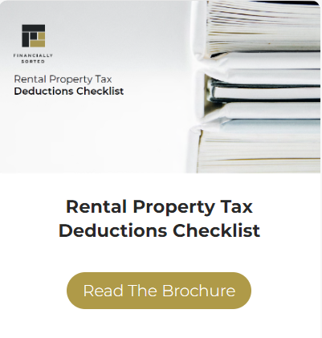
Property Investors
Property Investors
Notes:
For those of you as property investors, its important that you have your records up to date, you understand what is tax deductible & what extra you can do to legally minimise any tax liability.
This may include pre-paying expenses, what is the difference b/w repairs & maintenance vs capital/structural improvements or is my mortgage the best it can possibly be.
On our website under resources, there are 2 great publications that list every possible tax deduction available, goes into more detail around a few of the bigger expenses like depreciation, interest and R & M.
Be sure to access & certainly ask if you have any questions.

Slide 47
Keeping The Banks Honest
Keeping the Banks Honest
Many clients are refinancing as we speak – lock in cheaper rates & put cash buffers in place for future opportunities
Investment loans should still be starting with a 2%
Loan broker – we regularly/annually review our client's loans
Contact - Lucy Ramunno on lucyr@financiallysorted.com.au
or 9370 4800
❑Objective – go shopping to save money, it’s a free service to you
Notes:
Interest rates are climbing and the experts tip that they will continue to rise.
Explain why they are rising?

Slide 48
Financial Planning
Financial Planning & Insurances – the importance of it
What effect has the past 2 years had on your superannuation balances, does your insurance levels need to change & how are your various investments performing?
Wealth & Financial Planning becomes imperative
Contact - Dasith Monnekulame on dasithm@financiallysorted.com.au or 9888 3175
❑Objective – get yourself Financially Sorted!!!

Slide 49
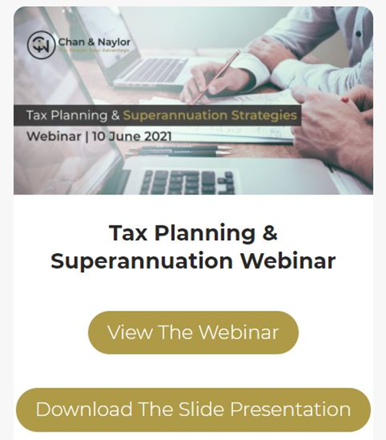
Website
Webinars
Webinar – to be added
Access via our website:
Watch
Download Presentation
https://www.financiallysorted.com.au/webinars/
Notes:
Via our website, you will be able to watch a copy of this webinar along with downloading a copy of the slides also.
As previously mentioned, please allow us 24-48 hours after the conclusion of this webinar to update to update our website.
Previous webinars also available – from last years budget, to property webinars and the recently held small business webinar held last month.
Explain where to watch on website & highlight web address above.
Also check out our webpage for plenty of free resources, brochures and some exciting new things coming soon.
Tax time is fast approaching – over 30 occupation guides to ensure that you legally minimise the taxes you have to pay.
PDF & e-teax-checklists will also be up soon.
Client portal – upload & storage.
Like us on social media also to keep updated. The various links, etc. can be found on our website.

Slide 50
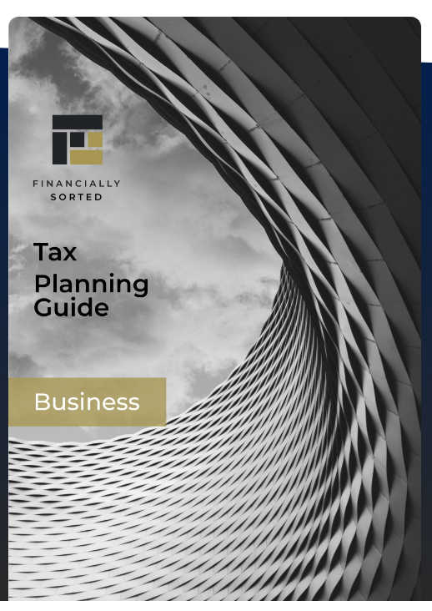
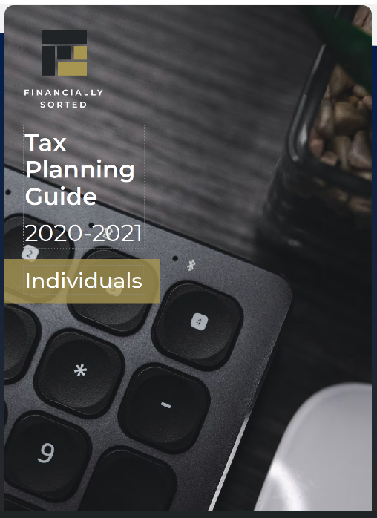
Website
Tax Planning Guides
Download from our website
https://financiallysorted.com.au/webinars/
Notes:
One brochure for individuals & one for businesses also.
We will add this brochures to the webinar section with the PDF slides also.

Slide 51
Website
Occupation Guides
Download from our website
https://financiallysorted.com.au/webinars/
Notes:
Over 30 occupation guides on our website for you to download.
Please access to assist you in legally minimising your taxes.

Slide 52
Next Steps
What to do next?
What should happen leading into the 30th June?
What should happen on the 30th June?
What should happen from the 1st July?
Notes:
Discuss the 3 questions above in relation to sales opportunities
Checklists, proformas to complete, many ideas and techniques to assist.

Slide 53
Contact Details
Next Steps
Talk to us for assistance
Make sure all compliance is up to date with ATO – ITR’s, BAS’s, Super
It’s time to get Financially Sorted!
❑Contact 03 9370 4800
Webpage www.financiallysorted.com.au
Email enquires@financially sorted.com.au

